Slide 1
Spurious local minima
周传赛 数学科学学院

Slide 2
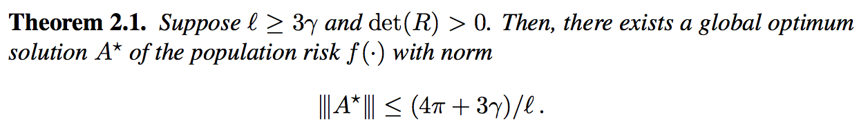
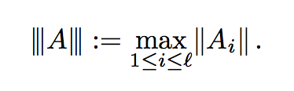
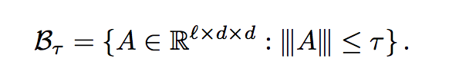
Identity Matters in Deep Learning
no spurious local minima

Slide 3
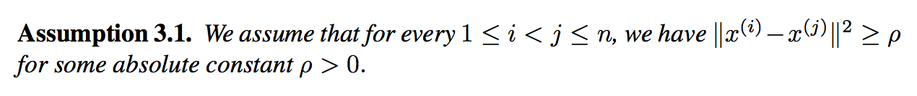
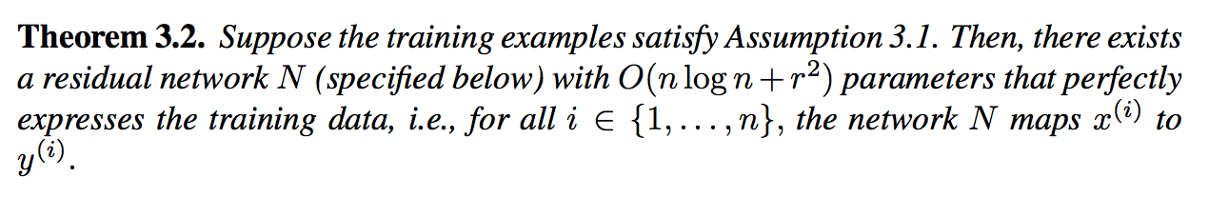
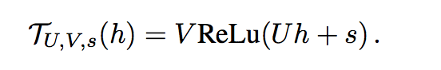
Identity Matters in Deep Learning
Representational Power of the Residual Networks
basic residual block

Slide 4
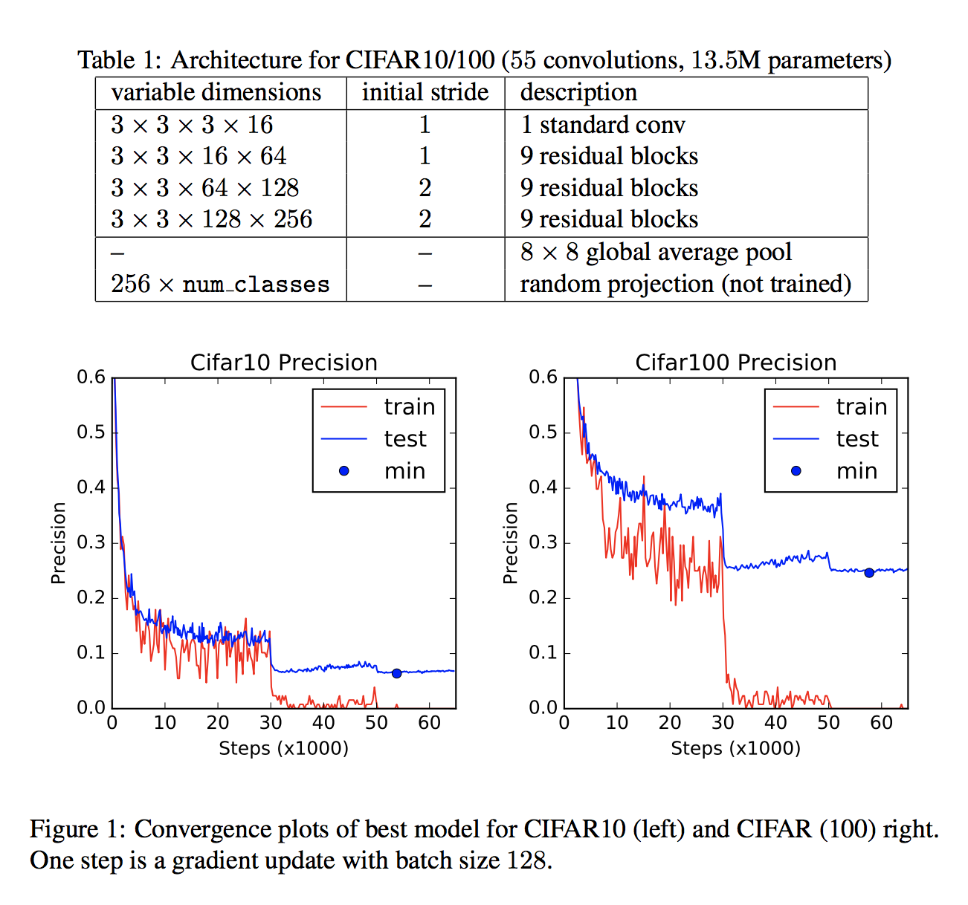
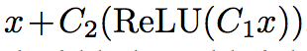
Identity Matters in Deep Learning
Each block：

Slide 5
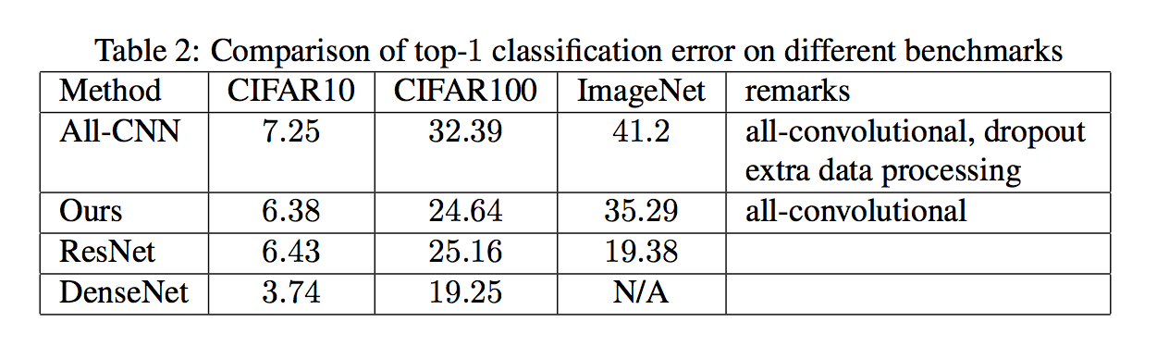
Identity Matters in Deep Learning

Slide 6
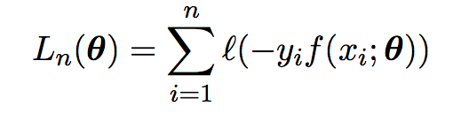
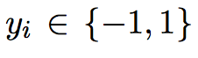
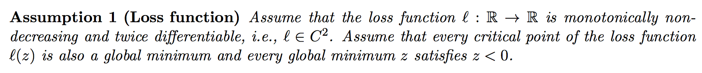
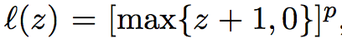
Adding one neuron can eliminate all bad local minima

Slide 7
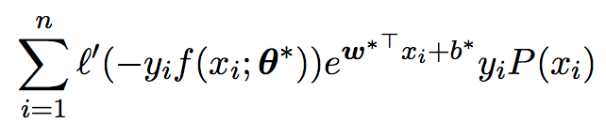
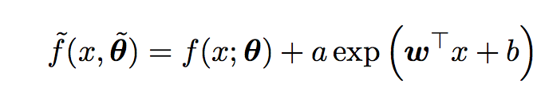
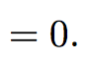
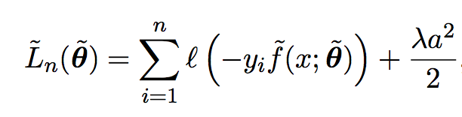
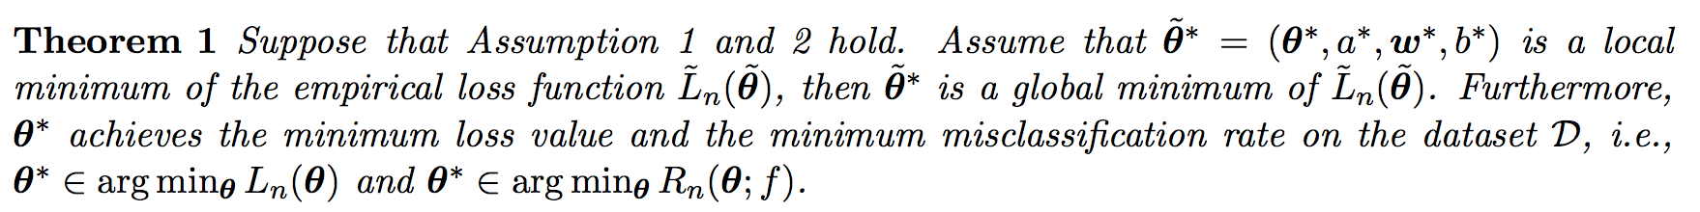
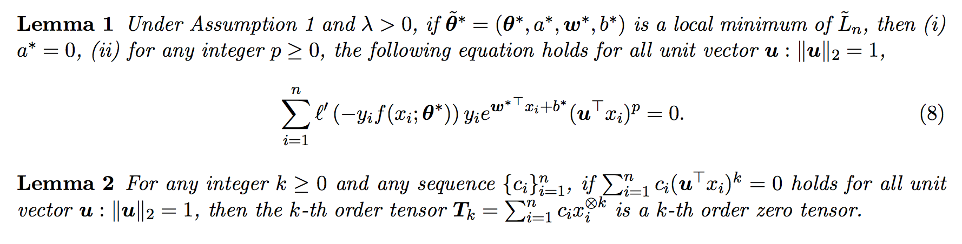
Main Results
Proof Sketch of Theorem 1

Slide 8
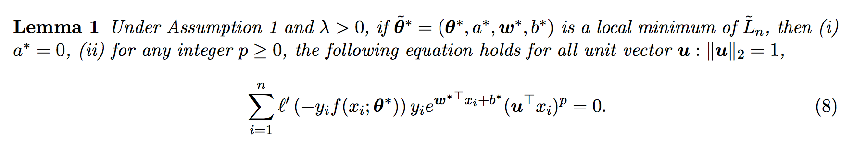
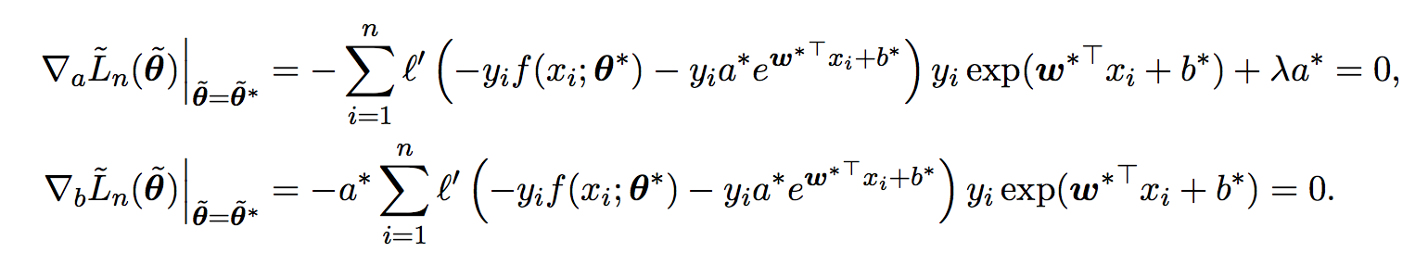
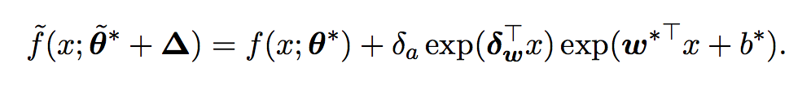
Proof Sketch of Lemma

Slide 9
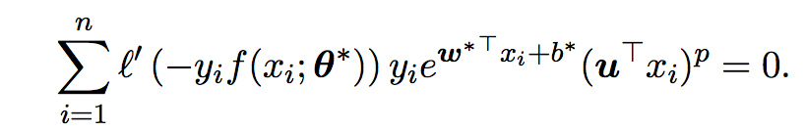
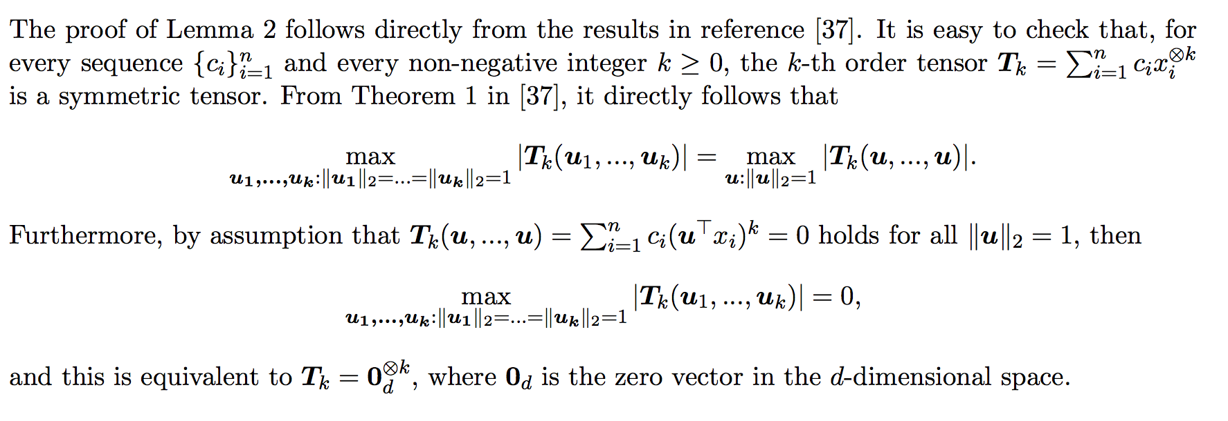
Proof Sketch of Lemma

Slide 10
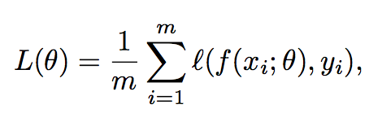
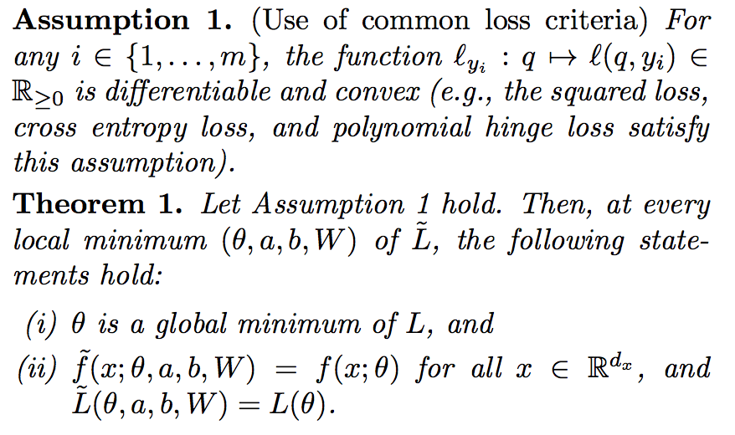
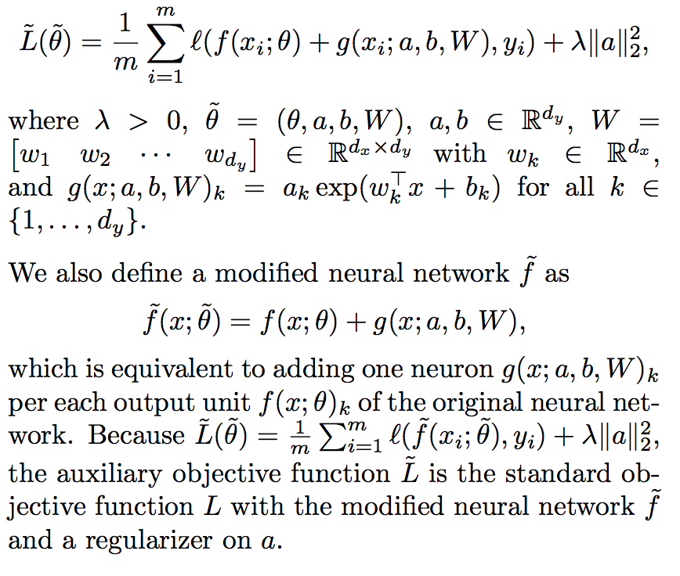
Elimination of All Bad Local Minima in Deep Learning

Slide 11
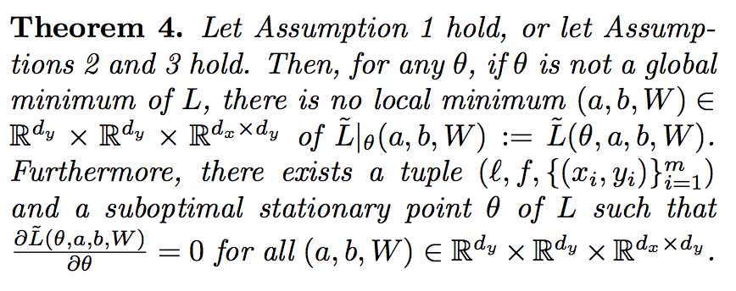
Elimination of All Bad Local Minima in Deep Learning
failure mode

Slide 12
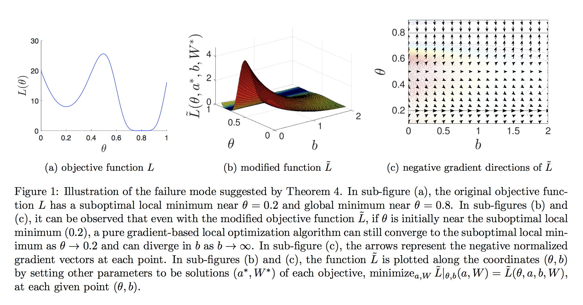
Elimination of All Bad Local Minima in Deep Learning

Slide 13
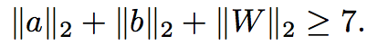
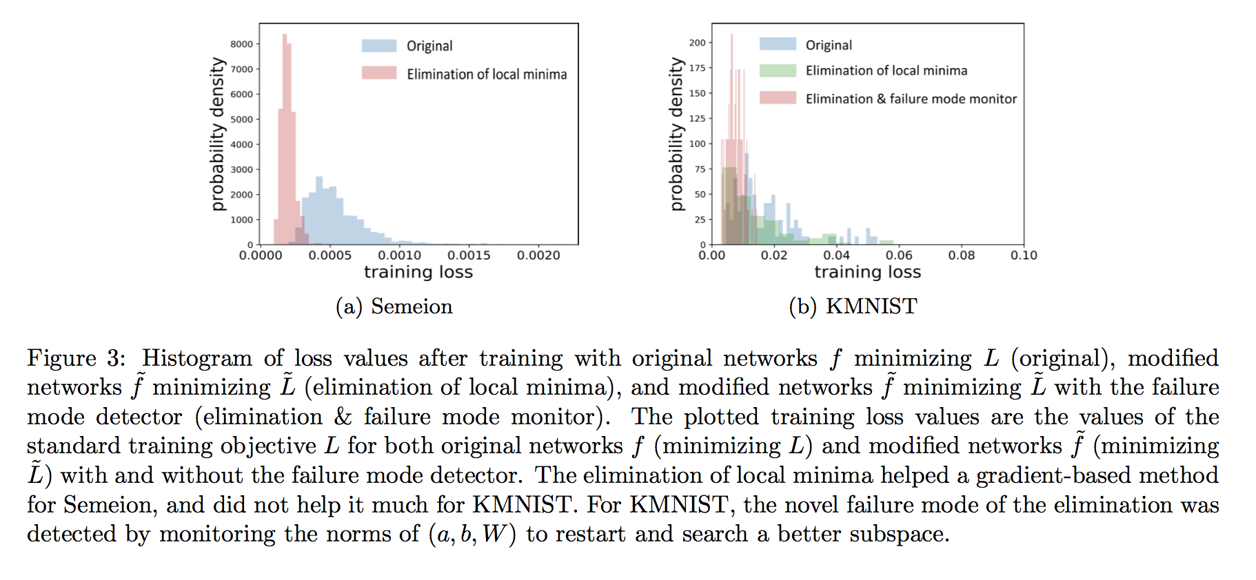
Elimination of All Bad Local Minima in Deep Learning
failure mode monitor

Slide 14
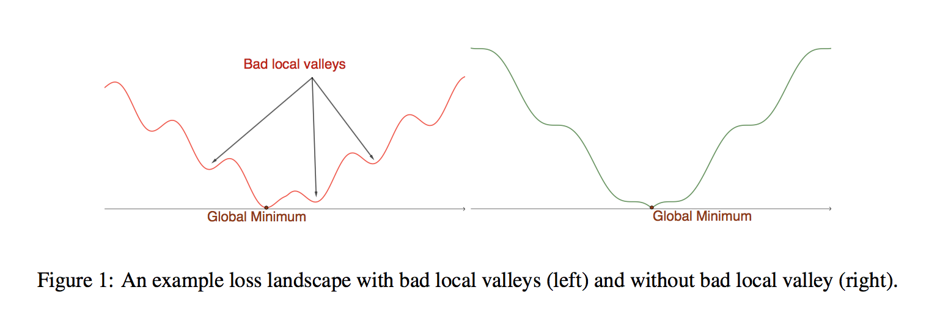
On the loss landscape of a class of deep neural networks with no bad local valleys

Slide 15
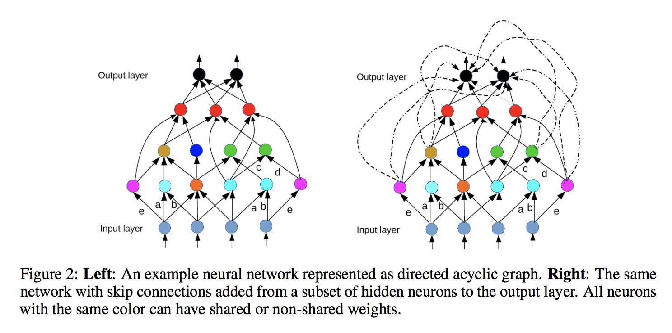
On the loss landscape of a class of deep neural networks with no bad local valleys

Slide 16
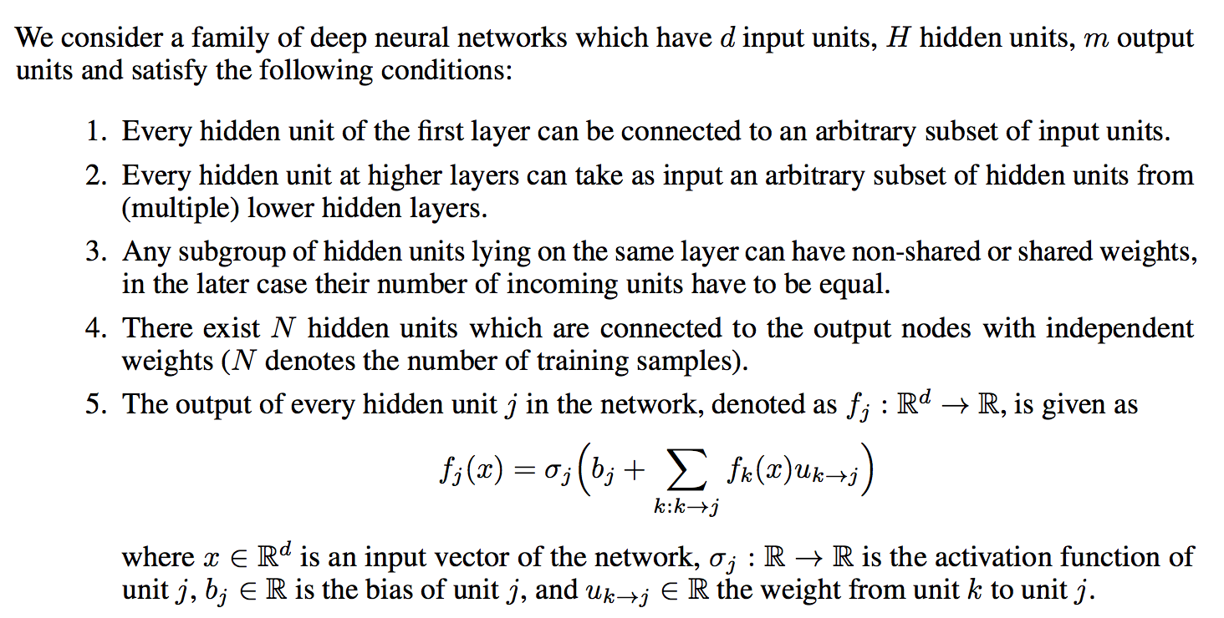
On the loss landscape of a class of deep neural networks with no bad local valleys

Slide 17
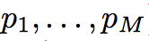
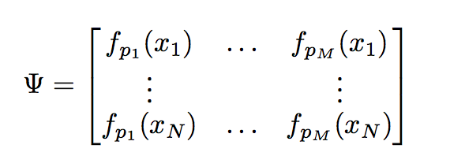
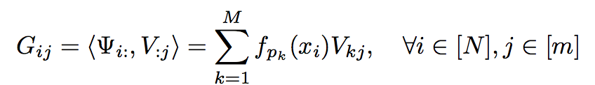
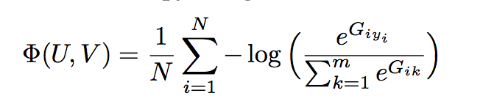
On the loss landscape of a class of deep neural networks with no bad local valleys
Suppose that are M hidden neurons directly connected to the output. Denoted as

Slide 18
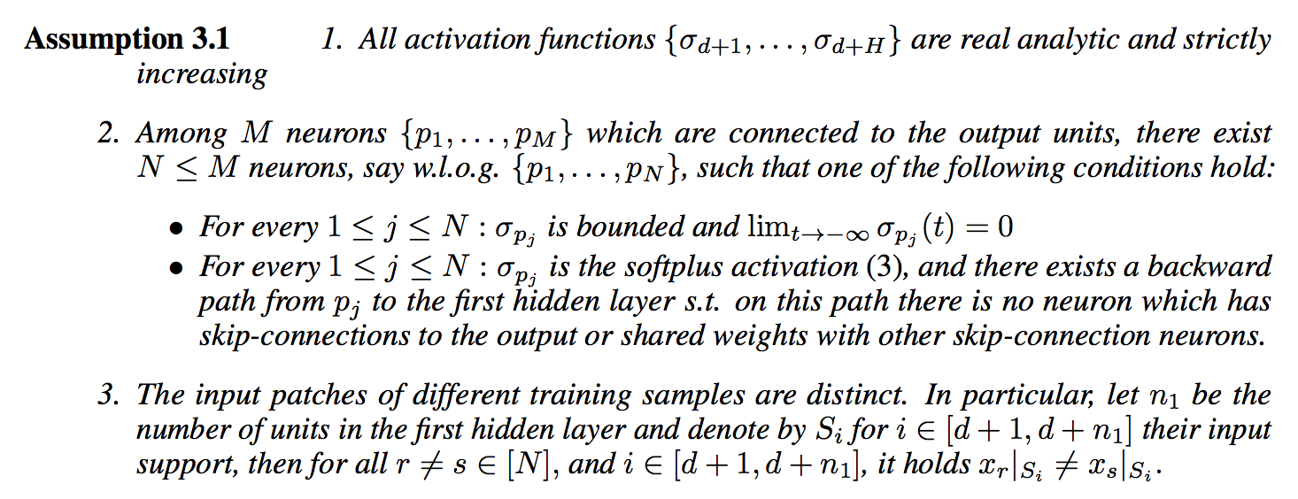
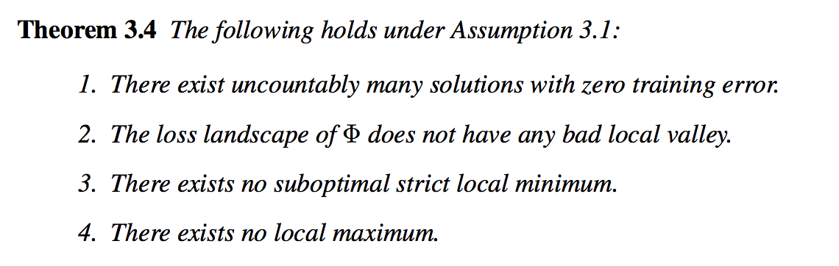
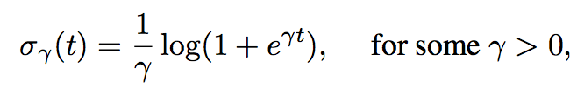
On the loss landscape of a class of deep neural networks with no bad local valleys

Slide 19
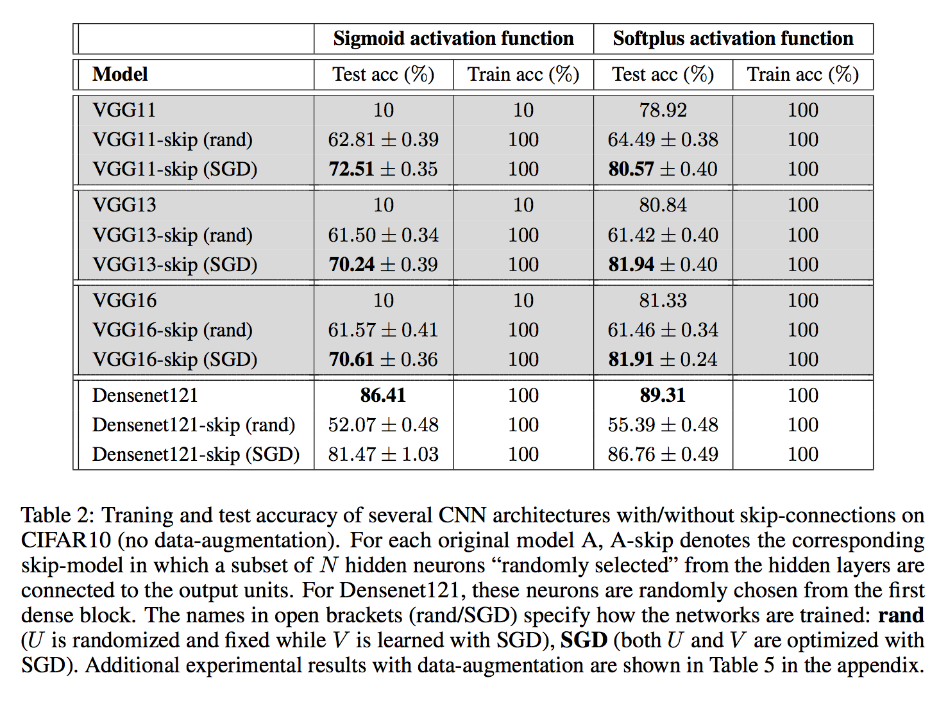
On the loss landscape of a class of deep neural networks with no bad local valleys

Slide 20
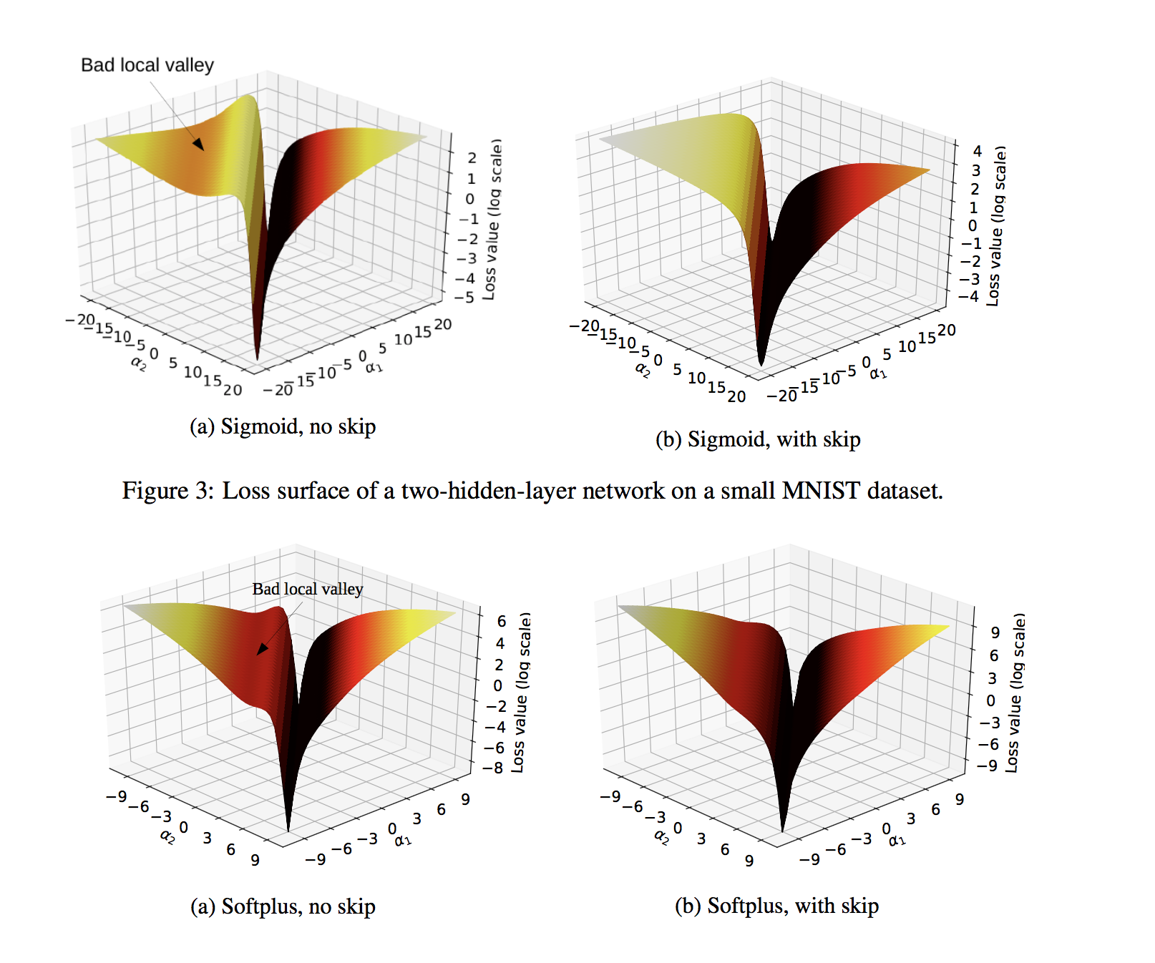
On the loss landscape of a class of deep neural networks with no bad local valleys

Slide 21
How Depth and Width impact local minima?
Effect of Depth and Width on Local Minima in Deep Learning

Slide 22
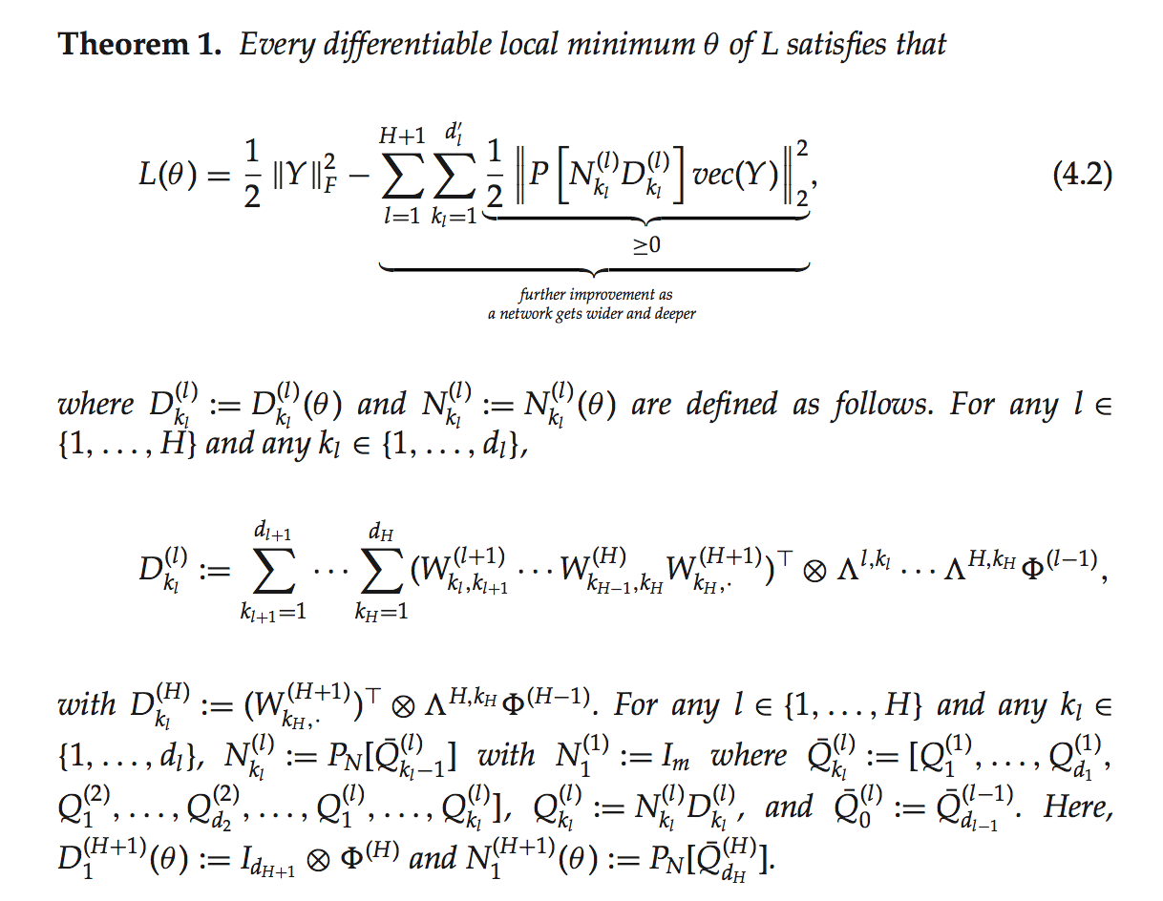
Effect of Depth and Width on Local Minima in Deep Learning

Slide 23
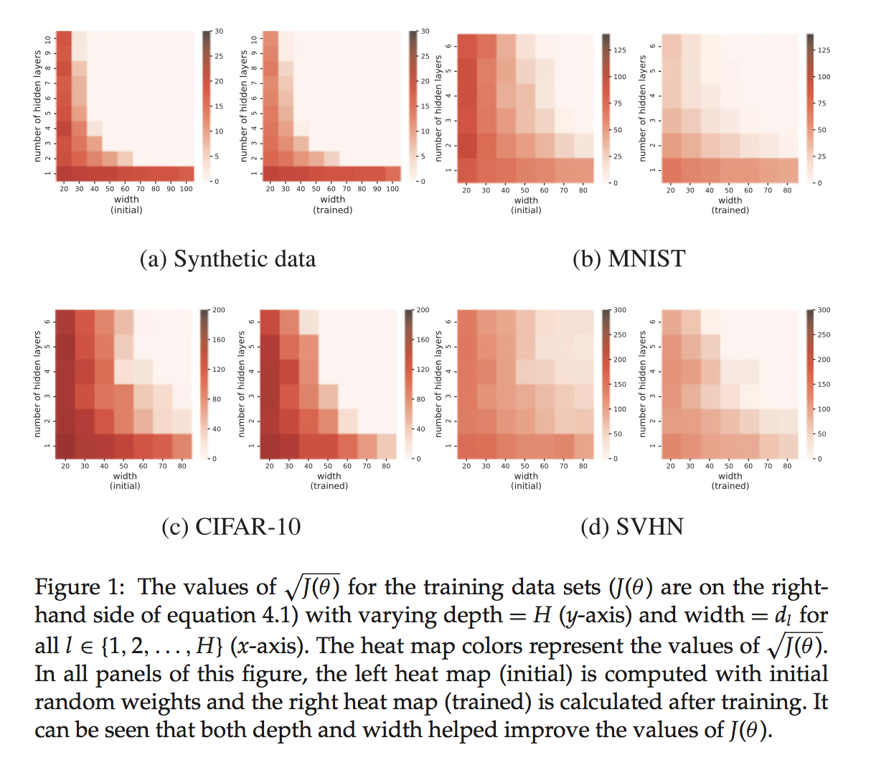
Effect of Depth and Width on Local Minima in Deep Learning

